Slide 1
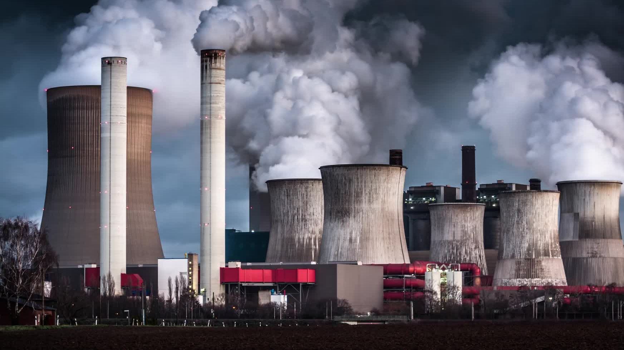
POWER GENERATION IN THE U.S (2008-2021)
-BY ABHINAV THUPILI

Slide 2
DATA DESCRIPTION
The current dataset is PUDL extracted from massive datasets published by the US government. The dataset shows the fuel receipts costs from the year 2008-2021.
The dataset consisted of 20 attributes with observations of 608,565.
The dataset showed various information about fuel receipts, like the type of fuel used, the amount of heat generated, the number of units received, etc.
To understand the power generation trends in the U.S, I have selected the following variables:
fuel_group_code (Type: Char).
fuel_received_units (Type: Num).
fuel_mmbtu_per_unit (Type: Num).
sulfur_content_pct (Type: Num).
ash_content_pct (Type: Num).
fuel_cost_per_mmbtu (Type: Num).

Slide 3

Problem Statement
What cluster has been formed based on the algorithm used?
Which cluster shows minimal and high Amount of heat produced?
What clusters show the minimal and high fuel cost?
Which clusters have the highest ash and sulfur output?
Which cluster is most optimal?

Slide 4
Analysis
PROCESS OF POWER GENERATION.
ANY FUEL IS SENT THROUGH THE TURBINE
FUEL BURNED TO PRODUCE HEAT WHICH BOILS THE WATER TO PRODUCE STEAM
STEAM IS PASSED TO SPIN THE TURBINE
TURBINE SPINS A GENERATOR WHICH PRODUCES ENERGY
Reference: https://www.tva.com/energy/our-power-system/coal/how-a-coal-plant-works#:~:text=Coal%2Dfired%20plants%20produce%20electricity,to%20start%20the%20process%20over.

Slide 5
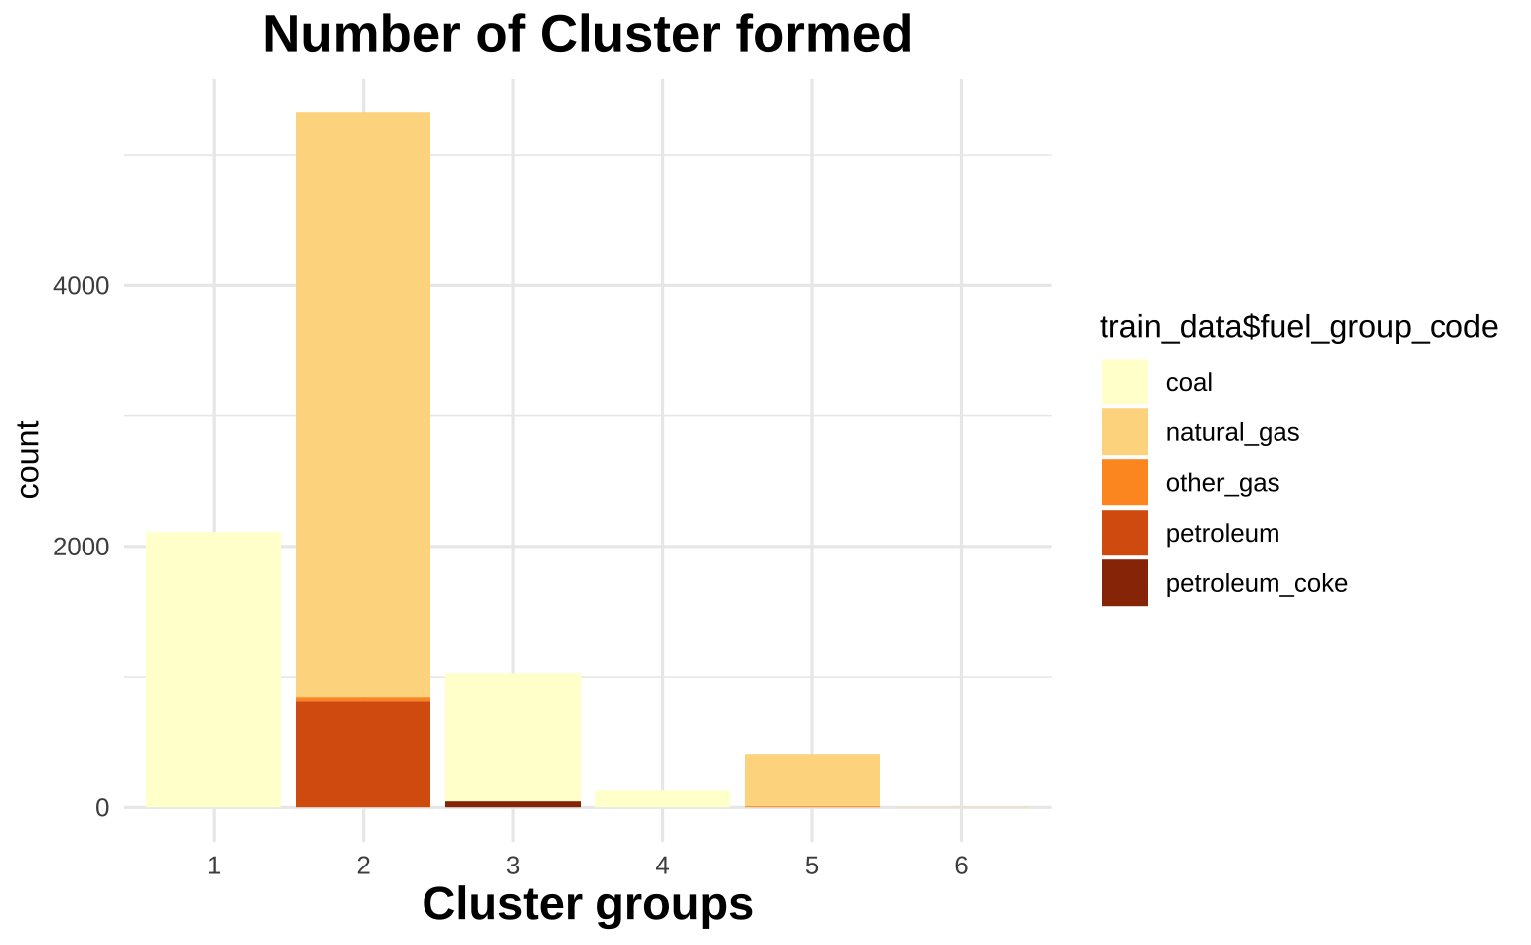
Analysis
Using Kmeans clustering, The number of clusters formed is 5.
The fuel types are clustered in these 5 clusters.
Cluster 1 – shows most of the coal received and a minor part of petroleum coke.
Cluster 2 – shows most of the majority of Natural_gas. And consists of other_gas, and petroleum.
Cluster 3 – This cluster shows a major part of coal.
Cluster 4 – Only has major data points of natural_gas and minor data points of other_gas.
Cluster 5 – This cluster has natural_gas and other_gas.
Cluster 6 – This cluster has only 3 data points with natural_gas.

Slide 6
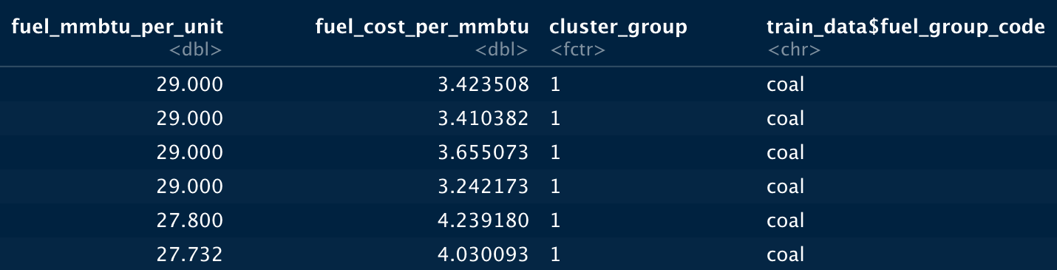
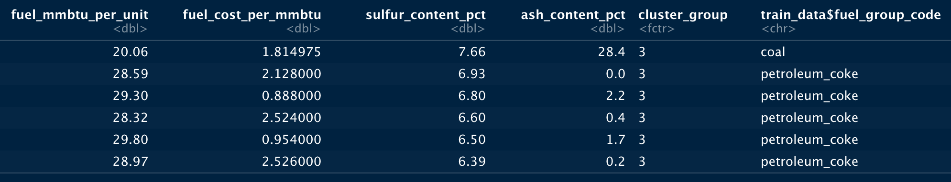
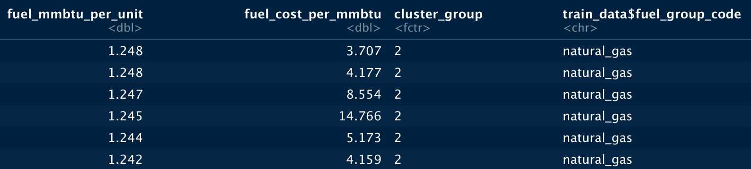
Analysis

Slide 7
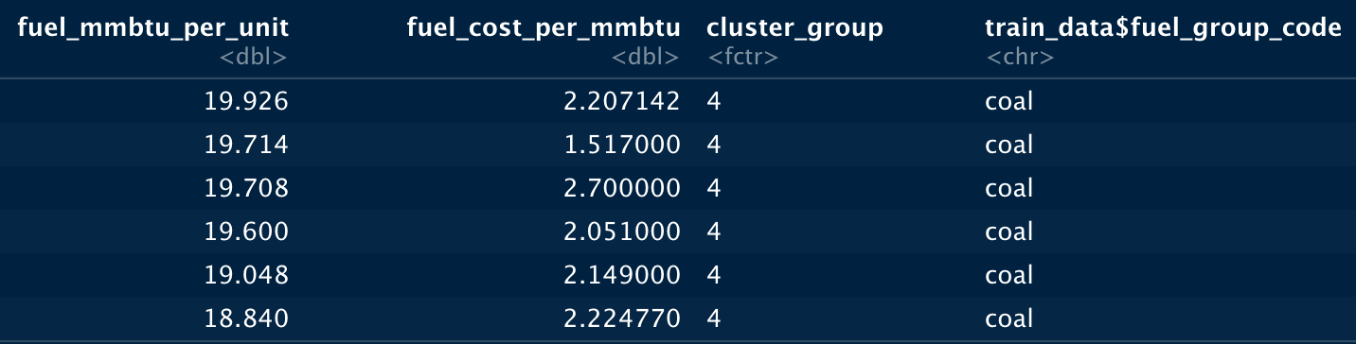
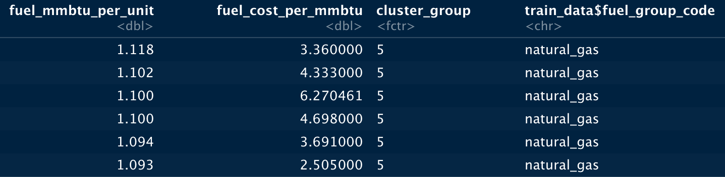
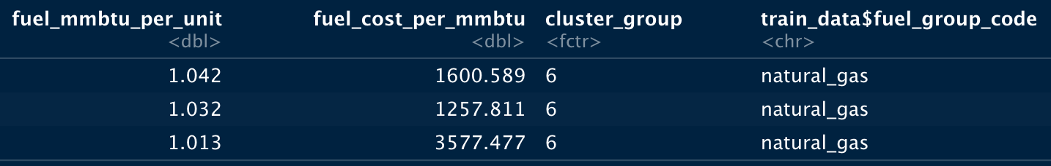
Analysis

Slide 8
CONCLUSION
The fuel cost in the clusters is directly impacted by the fuel type used according to the clusters formed. Even though the cost of producing heat for clusters 1, 3, and 4 is less, the groups also have sulfur and ash cost content. This will impact the efficiency of power generation concerning fuel cost.
Clusters 2 and 5, and 6 show high fuel costs; this could be because of the fuel sources used to produce the heat output.
Cluster 5 has only natural_gas. Though this cluster's heat output is minimal, no additional byproducts like sulfur and ash output exist. This reduces the cost of generating heat compared to other clusters.

